Slide 1
Lent Bible Study
March 16
March 23
March 30
April 6

Slide 2
Opening Prayer
Come Holy Spirit,
And You shall renew the face of the earth.
Let us pray.
O God, who by the light of the Holy Spirit, did instruct the hearts of the faithful, grant that by the same Holy Spirit we may be truly wise and ever enjoy His consolations.

Slide 3
Lenten Bible Study Topical Outline
March 16
Introduction.
The Prophet King comes to Jerusalem
The Prophet King Teaches in the Temple
March 23 – Eschatological Sermon / Arrest & Trial
March 30 – The Eucharist.
April 6 – Crucifixion & Resurrection of Christ.

Slide 4
Catholic Bible Study Introduction
CCC#113: Sacred Scripture must be studied within the living Tradition of the whole Church.
CCC# 115-117: In every lesson the Biblical text is studied in accordance with the ancient tradition of the two senses of Scripture:
(1) Literal Sense: The text of Scripture.
(2) Spiritual Sense:
a) Allegorical - events that point to Christ (Faith)
b) Moral - events that leads us to act justly (How to Act)
c) Anagogical - seeing the eternal significance (Our Destiny)

Slide 5
Key Players
Chief Priests – Descendants of Aaron (Ordained Priesthood)
Scribes and Elders – “Levites” (lesser ministers)
Pharisees – Religious political group. (legal experts of the Law)
Herodians – Hellenized Jews (aligned with Roman rulers)
Sadducees – Religious political group.
Romans – Governed & taxed the Jews. (pagan Roman Empire)

Slide 6
The Prophet-King Comes to Jerusalem
Preparation for entry. Matt: 21: 1-5
Triumphant Entry. Matt: 21: 6-11
Cleansing of the Temple. Matt: 21: 12-17

Slide 7
Preparation for Entry into Jerusalem
Matthew 21: 1-5.
When they had come near Jerusalem and had reached Bethphage, at the Mount of Olives, Jesus sent two disciples, ² saying to them, “Go into the village ahead of you, and immediately you will find a donkey tied, and a colt with her; untie them and bring them to me. ³ If anyone says anything to you, just say this, ‘The Lord needs them.’ And he will send them immediately.” ⁴ This took place to fulfill what had been spoken through the prophet, saying, ⁵ “Tell the daughter of Zion, Look, your king is coming to you, humble, and mounted on a donkey, and on a colt, the foal of a donkey.”

Slide 8
OT Prophesies:
Two disciples are sent: [aligns with two OT prophecies]
See, the LORD proclaims to the ends of the earth "Say to daughter Zion, your savior comes!" (Is 62:11).
The words "daughter Zion" refer to the holy city of Jerusalem. (~ 25 x in the OT)
The Messiah will come not like a conquering king or military leader; He will come humbly as a Savior to His people.
Rejoice heartily, O daughter Zion, shout for joy, O daughter Jerusalem! See [Behold], your king shall come to you; a just savior is he, meek, and riding on an ass, on a colt, the foal of an ass (Zech 9:9).

Slide 9
Timeline
By Law, Passover must be celebrated on the 14th day of Nisan (Thursday)
Jesus had Sabbath dinner at Bethany. 9th day of Nisan (Saturday)
Jesus entered Jerusalem on the 10th day of Nisan (Sunday)
Passover victims were chosen in the first Passover [Exodus 12:3]
Day that Joshua crossed the Jordan river [Joshua 4:19]
“Hosana” - Acclamation of the Messiah’s arrival “Parousia” (GK)
Psalm 118 (Messianic Psalm)
²⁵Save us, we beseech you, O Lord! O Lord, we beseech you, give us success!
²⁶ Blessed is the one who comes in the name of the Lord. We bless you from the house of the Lord.
²⁷ The Lord is God, and he has given us light. Bind the festal procession with branches, up to the horns of the altar.

Slide 10
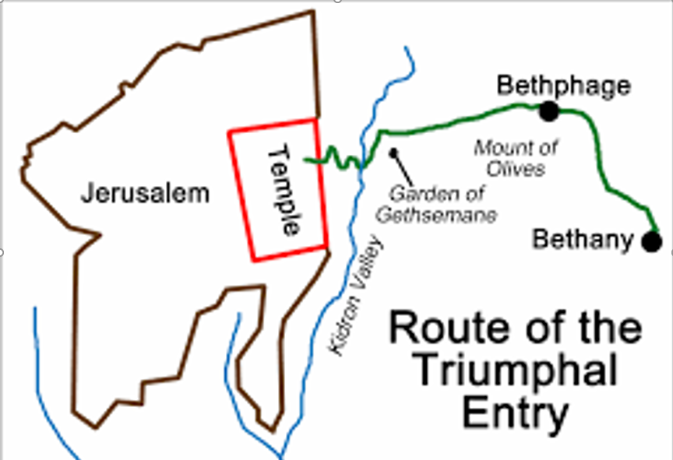

Slide 11
Cleaning of the Temple (?)
Matthew 21: 12-13
¹² Then Jesus entered the temple^{[c]} and drove out all who were selling and buying in the temple, and he overturned the tables of the money changers and the seats of those who sold doves. ¹³ He said to them, “It is written, ‘My house shall be called a house of prayer’; but you are making it a den of robbers.”
The merchants in the Temple area were selling doves that were the sacrifices of the poor ( Lev 12:6-8; 14:22; 15:14, 29).
They were also exchanging coins that bore pagan images or the images of the Roman emperor that were not accepted to purchase sacrifices or for Temple donations for Jewish coinage or Tyrian coins that bore no forbidden images (Ex 30:11-16).
Jesus fulfills the prophecy of Malachi: (Mal 3:1b-2a) and the prophecy of the Zechariah that in the era of the Messiah ...there shall no longer be any merchant in the house of the LORD of hosts (Zec 14:21).

Slide 12
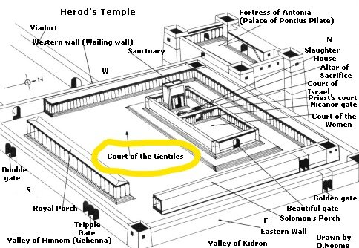

Slide 13
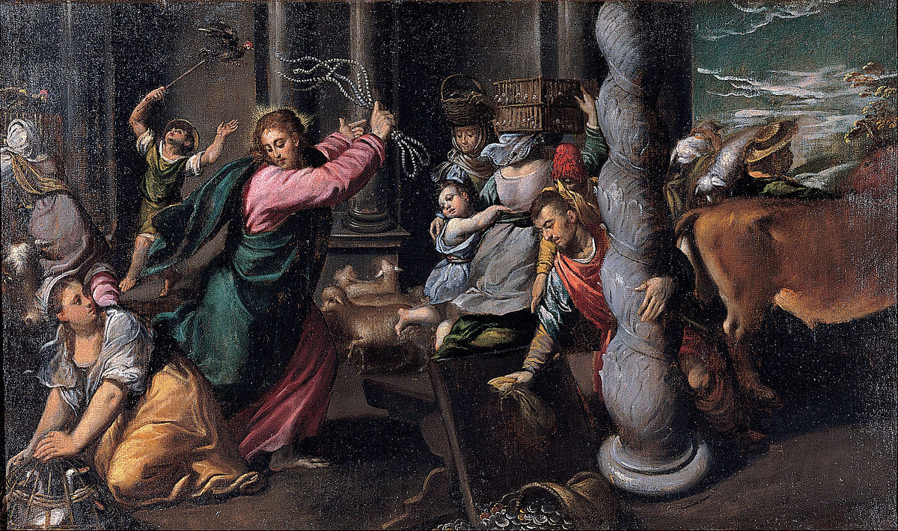

Slide 14
Notes

Slide 15
Jesus’s Teaching in the Temple
Jesus denounces the practices of the Temple leaders. Matt: 23:1-12
Seven Woes. Matt: 23 : 13-32
Coming judgement. Matt: 23: 33-36

Slide 16
Chair of Moses
Matthew 23: 1-12
Then Jesus said to the crowds and to his disciples, ² “The scribes and the Pharisees sit on Moses’ seat; ³ therefore, do whatever they teach you and follow it; but do not do as they do, for they do not practice what they teach. ⁴ They tie up heavy burdens, hard to bear, and lay them on the shoulders of others; but they themselves are unwilling to lift a finger to move them. ⁵ They do all their deeds to be seen by others; for they make their phylacteries broad and their fringes long. ⁶ They love to have the place of honor at banquets and the best seats in the synagogues, ⁷ and to be greeted with respect in the marketplaces, and to have people call them rabbi. ⁸ But you are not to be called rabbi, for you have one teacher, and you are all students.^{[b]} ⁹ And call no one your father on earth, for you have one Father—the one in heaven. ¹⁰ Nor are you to be called instructors, for you have one instructor, the Messiah. ¹¹ The greatest among you will be your servant. ¹² All who exalt themselves will be humbled, and all who humble themselves will be exalted.

Slide 17
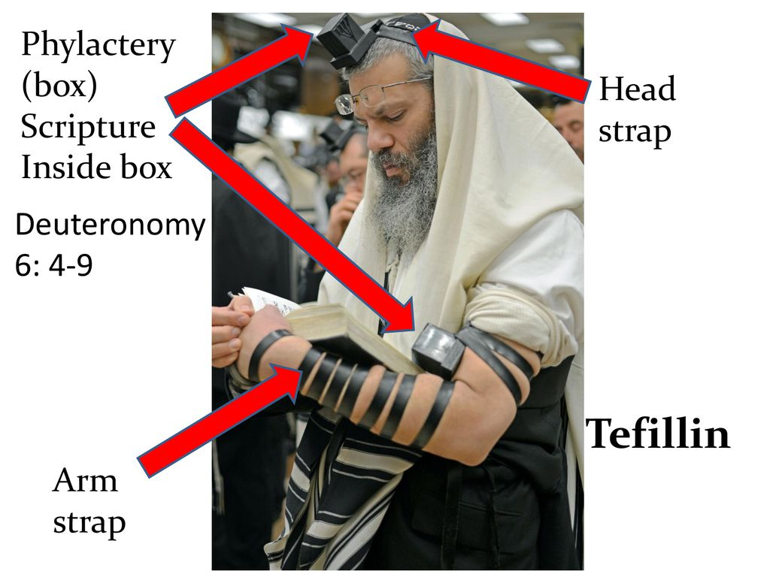
Phylactery (Heb: Tefillin)

Slide 18
Chair of Moses (b)
The Chief Priests held this authority in the Temple.
Teaching and ruling authority of the Pharisees and Scribes in the synagogues.
Examples:
The Pharisees' misinterpretation of the Law has made the Law a burden to the people.
Their excessive show of piety is a “hypocrisy.”
They delight in being honored and singled out for praise, putting themselves above the common people.

Slide 19
Seven Woe’s
Mathew 23:13-32
“ouai” (Gk) “howy” (Heb)
An expression of impending judgment by God, especially in the context of a covenant lawsuit by announcing that the curses of the covenant were about to be put into effect.
¹³ “But woe to you, scribes and Pharisees, hypocrites! For you lock people out of the kingdom of heaven. For you do not go in yourselves, and when others are going in, you stop them. ¹⁵ Woe to you, scribes and Pharisees, hypocrites! For you cross sea and land to make a single convert, and you make the new convert twice as much a child * of hell as yourselves. [* Jesus is saying they lead converts to hell]

Slide 20
Coming Judgement
Matt: 23: 33-36
The Baptist and Jesus both called these men a "brood of vipers," the wicked children of the ancient serpent - Satan (Mt 3:7; 12:34).
This is the third time the phrase is applied to them (also see Rev 12:9).
The answer to Jesus' rhetorical question in verse 33 is that they cannot flee the coming judgment. ³³ You snakes, you brood of vipers! How can you escape being sentenced to hell?
Persecutions of Christians begins:
Sts. Peter and John arrested; they murder St. Stephen and St. James Zebedee.
St. Paul was one of those sent by the Jewish Sanhedrin to arrest Christians before his conversion.* (Paul was a Pharisee)
In 66 AD the Jews revolted against Rome. The Romans send four legions of Roman soldiers into the Galilee and Judea.
The Temple was burned to the ground in 70 AD and the nation was destroyed, with the majority of the survivors sold into slavery.

Slide 21
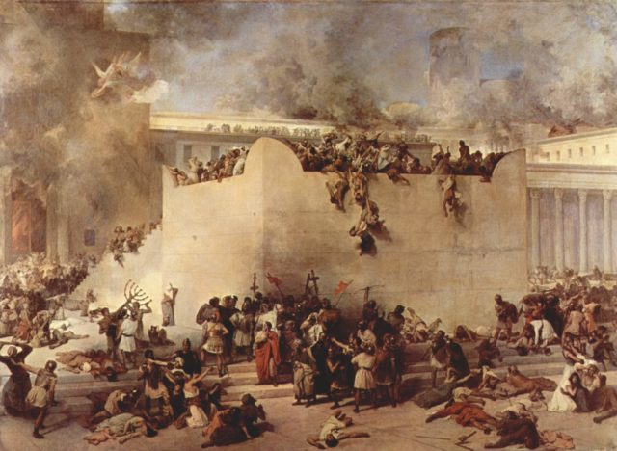
Destruction of Jerusalem

Slide 22
Questions for Group Discussion
What do you understand about God's promise of the bodily resurrection of the dead?
When do you profess this belief at every Sunday Mass?
2. How would you defend your belief in the resurrection to someone who questioned God's promise of a resurrection that rejoins body and soul?
See the Old Testament passages in Is 25:8; 26:19; Ps 73:24-25; Dan 12:1-3; the New Testament passages in Lk 14:14; Jn 5:29; 11:24-25; Acts 17:32, 23:6; 24:15, 21; Rom 1:4; 6:5; 1 Cor 15:12-24, 42-43; Phil 3:10-11; 1 Thes 4:16-17; Heb 6:2; 11:35. For N.T. passages concerning Jesus' Resurrection that prefigures our resurrection see Mt 27:53; Acts 1:22; 2:31; 4:2, 33; 17:18; Rom 6:5; Phil 3:10-11; 1 Pt 1:3; 3:21 and the Catechism references in CCC 349, 366, 556, 988-1013, 1038, 1524 and 2301.
3. Revelation 20:5-6 speaks of the "first resurrection;" what is the "first resurrection" and what then is the "second resurrection"? What is the first death and what the "second death" that is mentioned in Rev 2:11. See Jn 3:3 and 5; Rev 20:6-15; 21:8 and CCC 720, 782, 1215, 1225. Hint: the Fathers of the Church had a saying concerning these events: "Born once, die twice; born twice, die once.“
4. Will there be a resurrection of the righteous as well as the wicked? How will their fate be different? See Mt 25:31-46; Rev 20:11-15 and CCC 1038.

Slide 23
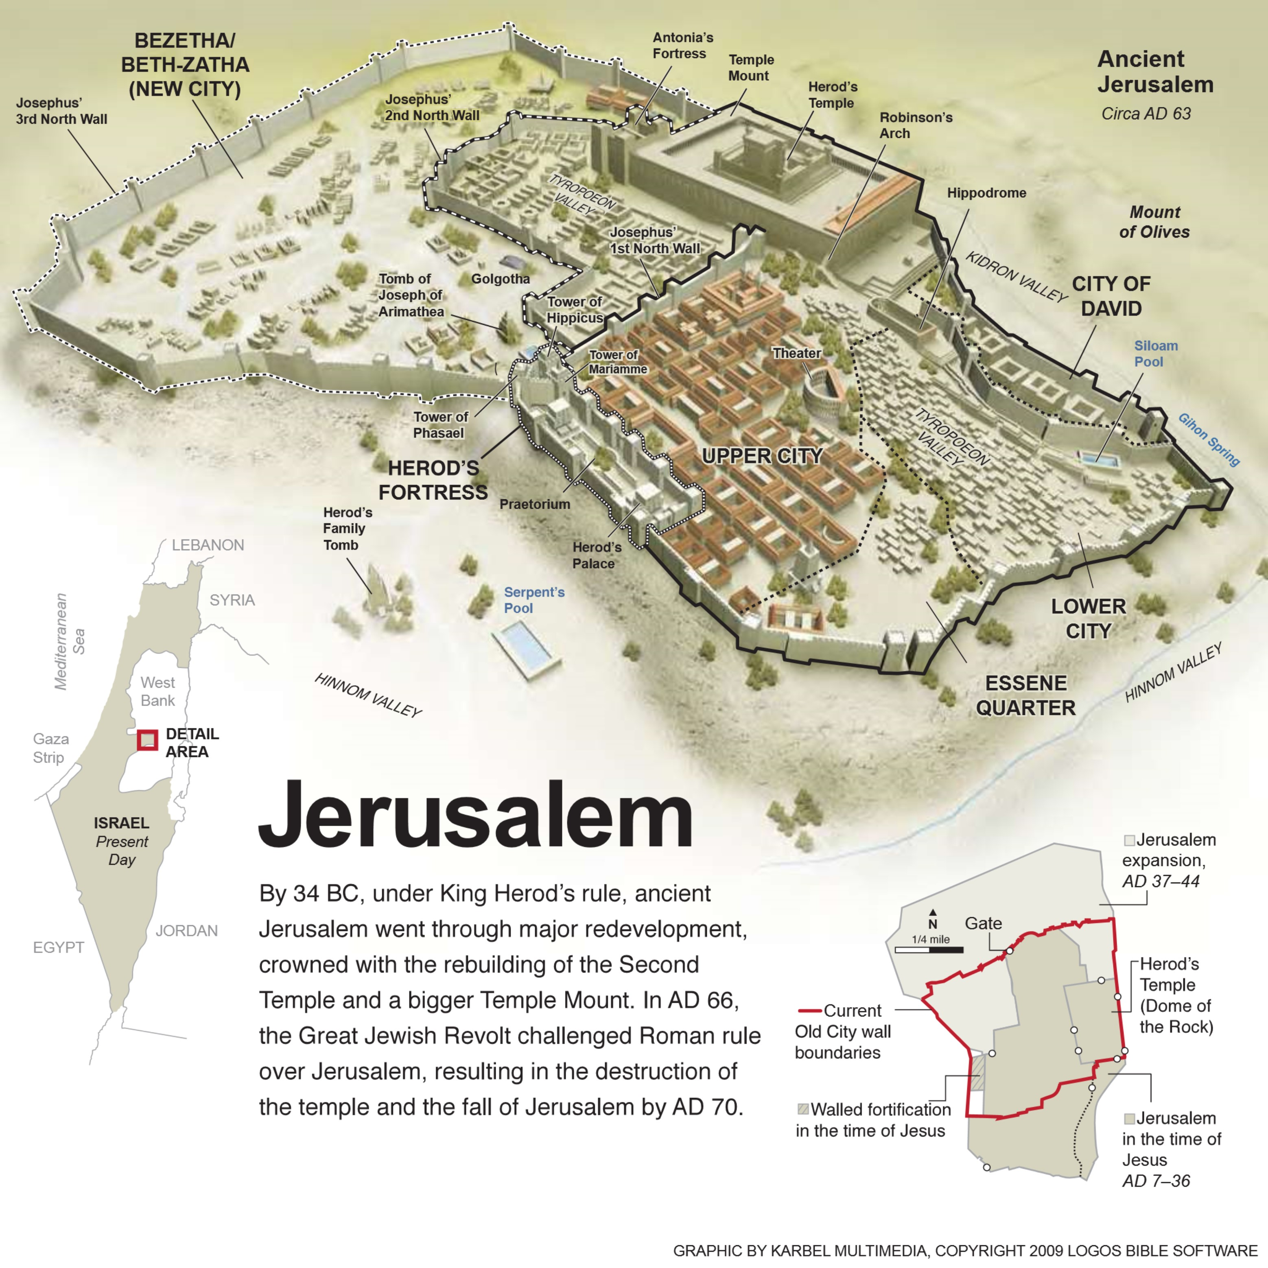

Slide 24
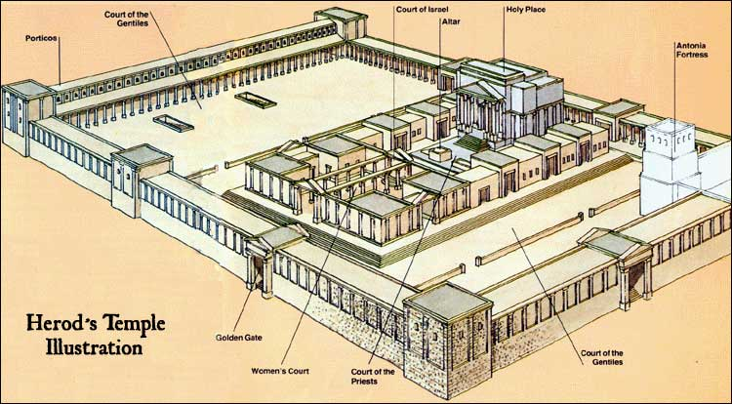

Slide 25
Closing Prayer
Lord, your word is a lamp to our feet and a light to our path.
We hank you that we can live in Your light and walk in Your truth.
May the things that you have revealed and thoughts that we have shared dwell in our hearts and stir us to action.
We ask all this through our Lord Jesus Christ. - Amen.

