Slide 1
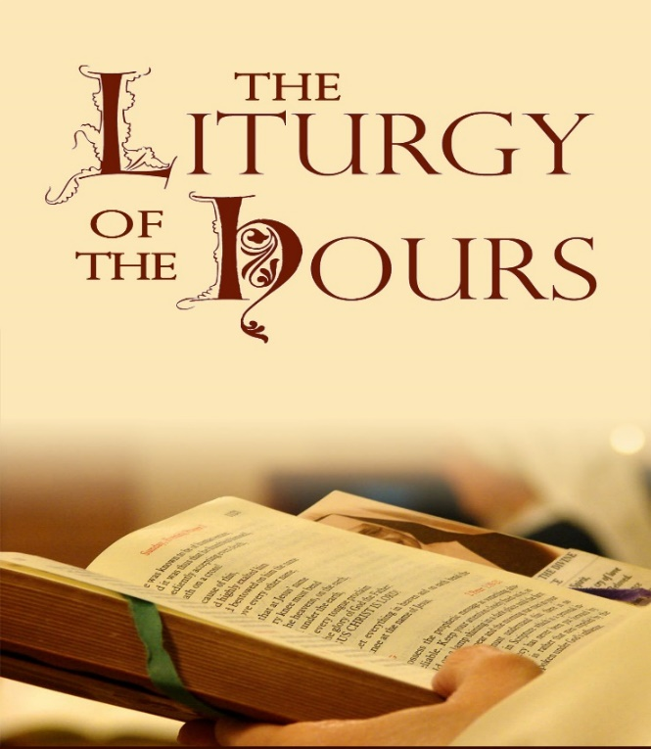
Praying With The Universal Church
DEACON DOUGLAS ASSELSTINE.

Slide 2
Prayer to the Holy Spirit:​
​
Come Holy Spirit, fill the hearts of your faithful and enkindle in them the fire of your love.​
​
Send forth your Spirit and they shall be created. And You shall renew the face of the earth.​ Amen.

Slide 3
CONTENT:
What is Liturgy of the Hours?
Brief history
How Do I get Started?

Slide 4
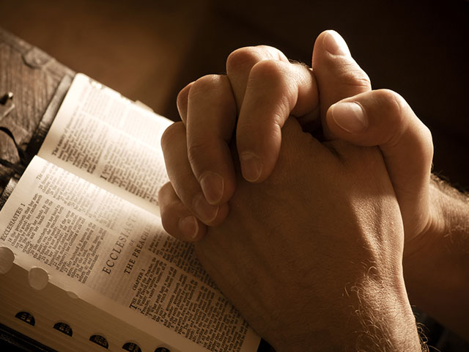
How is your prayer life?
…Relationship with God?

Slide 5
LOTH:
…is 2nd in rank to the Holy Mass.
Ancient definition of Liturgy: Work of the people:
"LIT" from Greek: "Laos" = people [the laity] & "Urgy" = (ergon) Energy or Work.
In the context of our Catholic worship (Latria) that is offered to God – Liturgy is:
(ii) Work of Christ done on behalf of the people. Means that Christ is doing the LITURGY. He is the principal liturgist. We are not able to save ourselves and make a pure offering to God. [Hebrews 5: 7-9]
(iii) As in the Mass…we offer our prayers and worship to the Father through Christ – “Through Him, With Him, and In Him in the unity of the Holy Spirit.”
Hypostatic union: The (divine & human) Christ is the “way” that – WE can participate in the heavenly liturgies.
Notes:
Luke 22:19 “Do this in remembrance of me” [Gk: Anemnesis] ; [Heb Zikkaron] Ex 12:14 and 1 Cor 5:7-8 / Note: LOTH is NOT a sacrament since it lacks form and matter] but it does confer GRACE through participation in the divine life
Compare Liturgy Vs. Devotionals

Slide 6
Catechism:
CCC 1069:
The word "liturgy" originally meant a "public work" or a "service in the name of/on behalf of the people." In Christian tradition it means the participation of the People of God in "the work of God." Through the liturgy Christ, our redeemer and high priest, continues the work of our redemption in, with, and through his Church.,

Slide 7
LOTH Is…
... The Sacrificial Prayer of the WHOLE church (both on earth and in heaven)
... Prayed by Laity, Clerics and Religious.
... Literary form is from Sacred Scripture: Psalms & Canticles
…Connected with the Mass* – extends the Eucharistic mystery. (PS. 22)
…Sanctifies: humanity, and the hours of each day.
...Vox Sponsae – “Voice of the Bride.”
Notes:
* Jesus took on our human nature – and thus Jesus joins all humanity to his Canticle of Praise to the Father. Through HIM – With HIM and In HIM. LOH extends the Eucharistic mystery.

Slide 8
Structure of LOTH

Slide 9
Ranking of the Liturgical Day.
Solemnity
Feast
Memorial
Optional Memorial
Ferial
* The Mass AND the LOTH of any given day must both follow the same liturgical ranking in the Ordo.

Slide 10
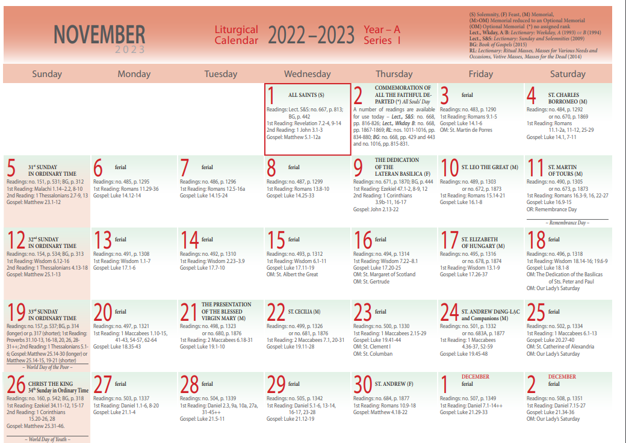
Calendar [Ordo]

Slide 11
The Canonical Hours. ”Seven times a day, I will praise you, Lord.” (Ps 119:164)
Office of Readings. (Anytime of the day)
Morning Prayer (Lauds).
Daytime Prayer:
- Mid-morning Prayer (Terce)
- Noon Prayer (Sext)
- Mid-afternoon (None)
Evening Prayer (Vespers)
Night Prayer (Compline)
Notes:
Morning and Evening Prayer are the two (chief hours) or hinges of the LOTH (Divine office) for the day.

Slide 12
Structured Cycles of LOTH
Consist of 7 daily prayers.
Minor “hours” cycle within one week.
Lauds & Vespers use a 4-week cycle.

Slide 13
Historical Context:
Shema – “Hear O, Israel…” - Recited in the Jewish home 3x per day. (Deut. 6:4).
LOTH usage with psalms evolved during the Babylonian exile (597 BC) See Daniel 3:38; & 6:10
During the Temple period, the Psalms were used by Levites - see Ps. 141:2 Later usage in the Apostolic period (Acts 3:1-3; 10:9-11; Eph 4:18-20)
Post apostolic period - rise of Monastic use. Developed by Desert Fathers & Western Monasticism (i.e., the Benedictines)
Vatican II - LOTH has been revised and simplified for Laity to participate. [S.C. Section IV]
Notes:
S.C. = Sacrosanctum Concilium [sacred council] from Vatican II

Slide 14
Structure of the Offices
Morning & Evening | Office of Readings | Daytime | Night
The first office of the day must begin with the Invitatory.
If not the first office of the day, begins with the opening versicle.
Hymn | Hymn | Hymn | Examination
Psalmody | Psalmody | Psalmody | Hymn
Reading | Responsory | Reading | Psalmody
Responsory | Scripture Reading | Responsory | Reading
Gospel Canticle | Responsory | Prayer | Responsory
Intersessions | Second Reading | Concluding prayer | Gospel Canticle
Lord’s Prayer | Responsory |  | Prayer
Concluding Prayer | Concluding Prayer |  | Concluding Prayer
Dismissal | Conclusion |  | Marian Antiphon
Notes:
Invitatory – from Latin invītāre, to invite. Ps 24, 67,95, 100 [ * Concluding prayer can be the collect of the solemnity celebrated at the Mass – this connects the LOTH with the Mass]

Slide 15
The Invitatory Prayer
The Invitatory is a Psalm that begins the liturgical day. (prayed only once per day)
Choose one from the following Psalms: 95, 67, 24, 100.

Slide 16
Steps with Invitatory
(1) Begin with: Lord + Open my lips and my mouth will proclaim your praise. (- Ps 51:17)
(2) Antiphon*
(3) Pray one Invitatory psalm
(3) Repeat the Antiphon*
(4) Glory to the Father...
(4) Then proceed to the Hymn.
* Antiphons are seasonal.

Slide 17
Steps Without the Invitatory
Steps:
(1) Begin with: God, + Come to my assistance, Lord make haste to help me.
(- Ps 69:2)
(2) Glory to the Father…
(3) Then proceed with Hymn

Slide 18
Saturday Morning Office in Memoriam to the BVM
Saturday Morning:
Only in Ordinary Time
Only If no other memorial or feast occurs on that day. (These will take precedence.)
See the prayers section of IBreviary (or page 1383 in Christian prayer.)

Slide 19
Psalter: “Masterwork of all Prayer.”
Catechism References:
1174-1178
2585 – 2586
2587- 2588
2599: “Prayed and fulfilled in Christ, the Psalms are an essential and permanent element of the prayer of the Church. ”

Slide 20
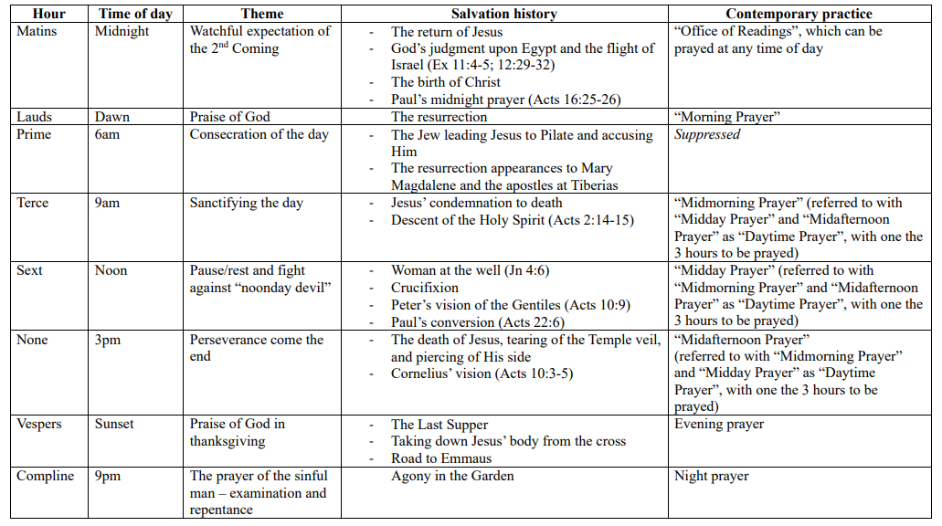
Themes of the “Hours”

Slide 21
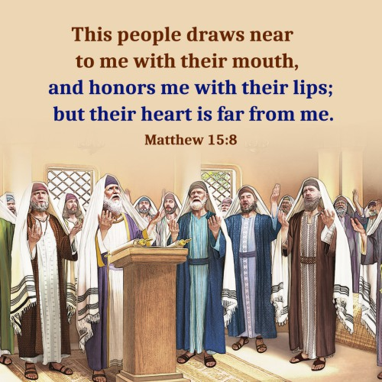
Praying with the Heart….

Slide 22
Resources:
Canadian Conference of Catholic Bishops [CCCB] “ORDO” https://www.cccb.ca/liturgy-sacraments/resources-in-english/liturgical-calendar/general-roman-calendar/
St. Thomas Moore House of Prayer (USA) - https://www.liturgyofthehours.org/todays-pages
Divine office website (USA) : https://www.liturgyofthehours.org/todays-pages scroll down to the bottom. The pages are also on the Divine Office App.
LOTH Hymns - http://kpshaw.blogspot.com/2013/08/thematic.html
https://catholicexchange.com/weve-missed-the-point-of-what-the-divine-office-is/?mc_cid=0ee993db6b&mc_eid=b5d066d692
https://www.youtube.com/watch?app=desktop&v=v6qqJAUCs00

Slide 23
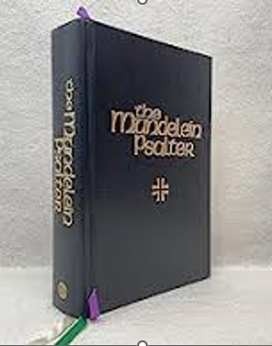
Mundelein Psalter
- Published by Mundelein University
- Primary resource for MP & EP
at the seminary
- Psalm tones are adopted from
Gregorian Chants.
- Grail format of Psalms for
use in the chant.

Slide 24
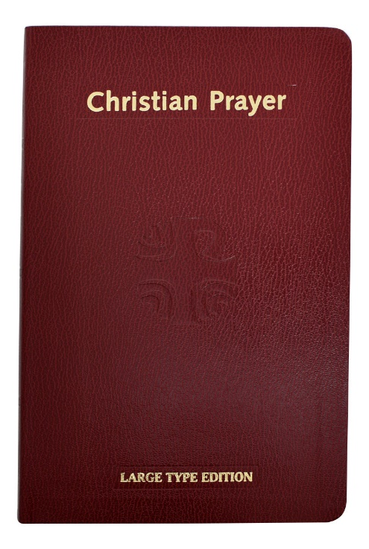
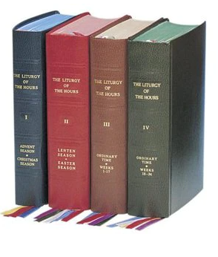
The Roman Breviary: Single & Four Volume ”
Christian prayer: Single Volume
These are being revised and will be out of print by ? December 2024. ?

Slide 25
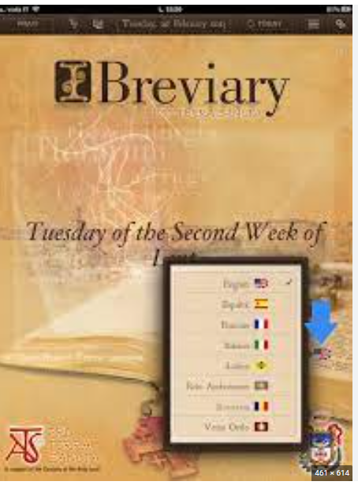
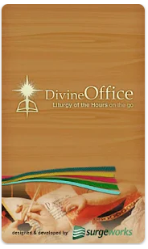
“Breviary Resources”
www.ibreviary.com
App available
www.divineoffice.org
App available.

Slide 26
“Breviary Resources”
www.universalis.com
App available

